Slide 1

T20 WORLD CUP ANALYSIS PROJECT
Using excel , python , sql and power bi
Presented by
M.Rama Priya

Slide 2
INTRODUCTION
This project focuses on analyzing the ICC T20 World Cup, one of the most dynamic formats in international cricket. With only 20 overs per side, the tournament emphasizes aggressive batting, strategic bowling, and quick decision-making. The dataset includes details such as team performances, player statistics, match outcomes, and tournament results. By analyzing these factors, we aim to:
Identify top-performing players and teams.
Understand batting and bowling patterns across matches.
Provide insights into winning strategies and key performance drivers.

Slide 3
Problem statement & Objectives
Problem Statement :
The ICC T20 World Cup produces massive volumes of data on teams, players, and matches. However, this data is scattered and not easily interpretable. Without structured analysis, it becomes difficult to:
Identify top-performing players and teams.
Understand key factors that drive match outcomes.
Compare performances across different editions of the tournament.
Objectives:
The main objectives of this project are:
To study team and player performance trends.
To analyze batting, bowling, and fielding statistics.
To compare performances across teams and tournaments.
To derive insights that highlight success factors in T20 cricket.

Slide 4
Work Strategy
🔹 Excel:
Used for initial data cleaning and formatting.
Verified missing values and ensured consistency across player/team data.
Performed quick summaries with pivot tables (strike rate, batting average, wickets).
🔹 SQL:
Queried the dataset to extract key insights (e.g., top run-scorers, leading wicket-takers).
Applied filtering and grouping to analyze team wins and player performance by role.
🔹 Python:
Conducted exploratory data analysis (EDA) with Pandas, NumPy, Matplotlib, Seaborn.
Visualized performance trends (e.g., distribution of player ratings, strike rate vs average, wickets by bowler type).
Identified correlations between features (e.g., boundaries %, economy rate, match outcomes).
🔹 Power BI:
Built interactive dashboards for openers, middle-order, bowlers, and team stats.
Highlighted KPIs such as boundary %, strike rate, total runs, and win ratios.
Created storytelling visuals for actionable insights (e.g., strongest batting order, key bowlers).

Slide 5
EXCEL:
🔹 Performed initial data cleaning (handled missing values, removed duplicates from match and player stats).
🔹 Checked data consistency (team names,player names,matchIDs,and formats).
🔹 Used pivot tables to explore run distribution by players, wickets by bowlers, and team-wise performances.
🔹 Verified data quality before moving to SQL and Python for deeper analysis.

Slide 6
SQL ANALYSIS
🔹 Queried the dataset to analyze runs by batsman, wickets by bowler, and win ratios by team.
🔹 Applied filtering and grouping to identify patterns in batting,bowling,and match outcomes.
🔹 Wrote SQL queries to calculate averages,strike rates, economy rates,and win percentages.
🔹 Extracted subsets of data(e.g.,top 5 run scorers,leading wicket takers,team performance by stage) for deeper analysis.

Slide 7
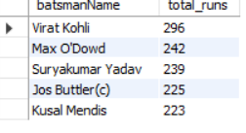
MY SQL QUERIES EXAMPLES & INSIGHTS;
SELECT batsmanName,SUM(runs) AS total_runs
FROM batting_summary
GROUP BY batsmanName
ORDER BYtotal_runs DESC
LIMIT 5;

Slide 8
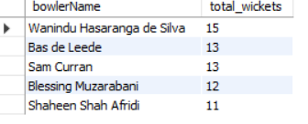
MY SQL QUERIES EXAMPLES & INSIGHTS;
SELECT bowlerName, SUM(wickets) AS total_wickets
FROM bowling_summary
GROUP BY bowlerName
ORDER BY total_wickets DESC
LIMIT 5;

Slide 9
PYTHON
🔹 Conducted Exploratory Data Analysis (EDA) using Pandas and NumPy on player and match data.
🔹 Identified relationships and correlations (e.g., strike rate vs average,economy rate vs wickets).
🔹 Used Matplotlib/Seaborn to visualize trends such as top run scores,leading wicket takers, and team win distributions.
🔹 Preprocessed data for creating Power BI dashboards and advanced visualizations.

Slide 10
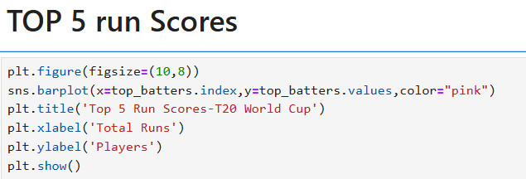
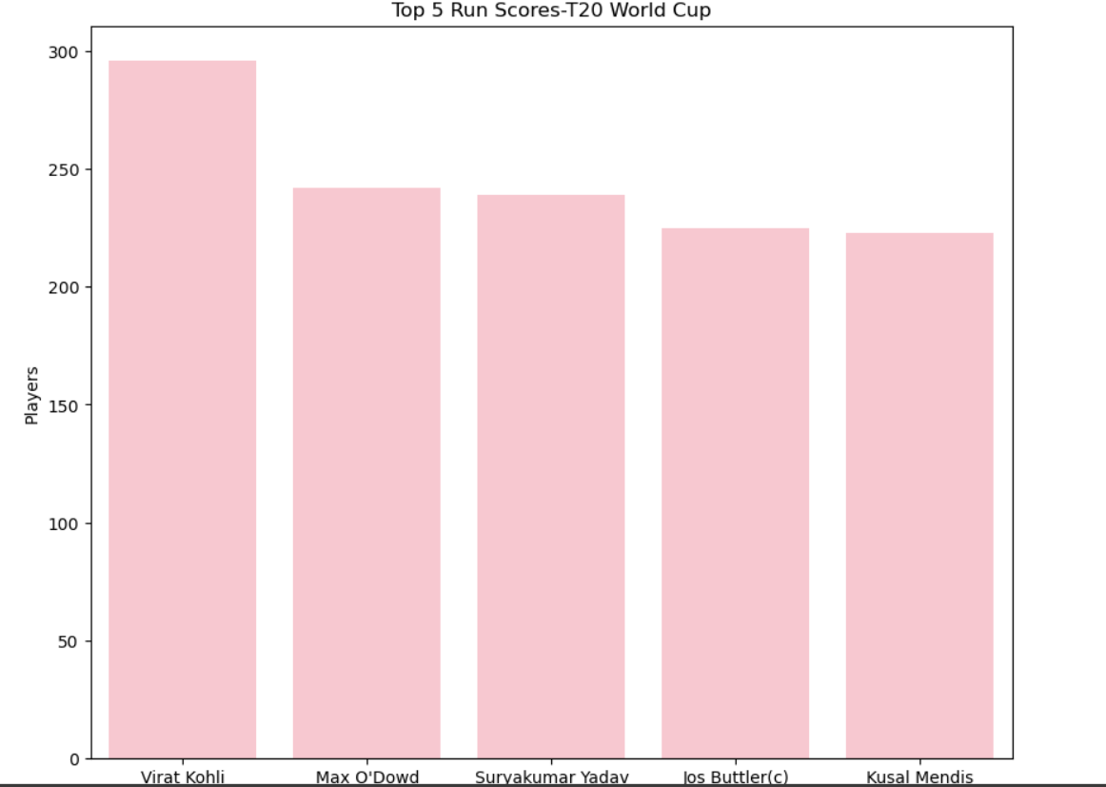

Slide 11
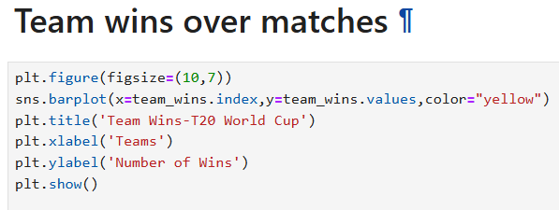
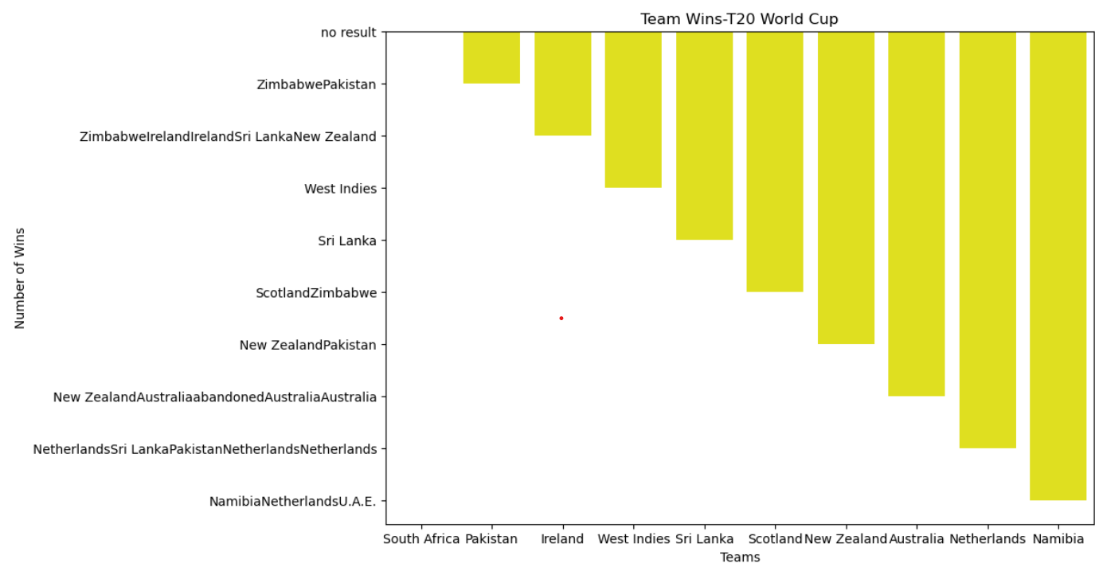

Slide 12
POWER BI:
🔹 Built interactive dashboards to visualize runs,wickets,and win percentages.
🔹 Highlighted team-wise and player-wise performance across different stages of the tournament.
🔹 Created visuals for batting strike rates,boundary %,economy rates, and match outcomes.
🔹 Designed user-friendly reports for coaches,analysts,cricket fans to understand key trends.
🔹 Enabled storytelling with data through compelling visuals of top players,match highlights,and tournament insights.

Slide 13
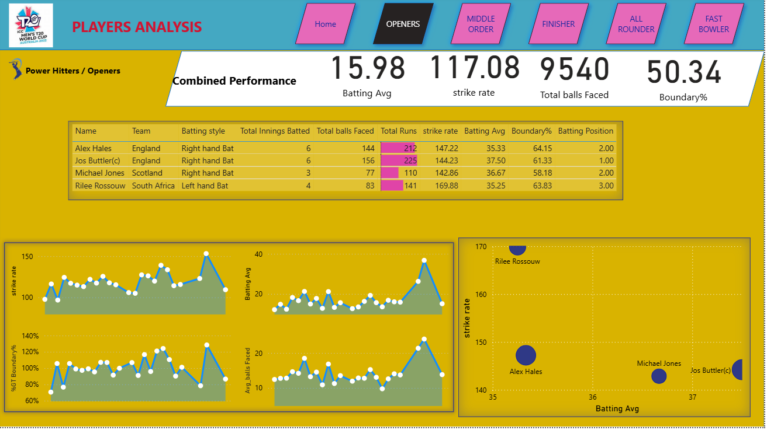

Slide 14
INSIGHTS:
•Powerplay performance strongly influences match outcomes-teams with high scoring rates in the first 6 overs often win.
•Death-over bowling(last 4 overs) plays a decisive role in restricting opponents.
•All-rounders provide balance-teams with strong batting + bowling all-rounders show higher win ratios.
•Top 5 runs scorers contribute to over 40% of their team’s total runs.
•Leading wicket-takers are mostly pace bowlers in powerplays and spinners in middle overs.
•Boundary % (4s & 6s) is a key differentiator between winning and losing teams.
•Teams with consistent batting partnerships(50+ runs) have a significantly higher chance of winning.
•Win percentages are highest for teams that successfully defend scores above 170.

Slide 15
THANK YOU

